Slide 1
OSI Model
The model
Functions of the layers
WCB/McGraw-Hill
© The McGraw-Hill Companies, Inc., 1998

Slide 2
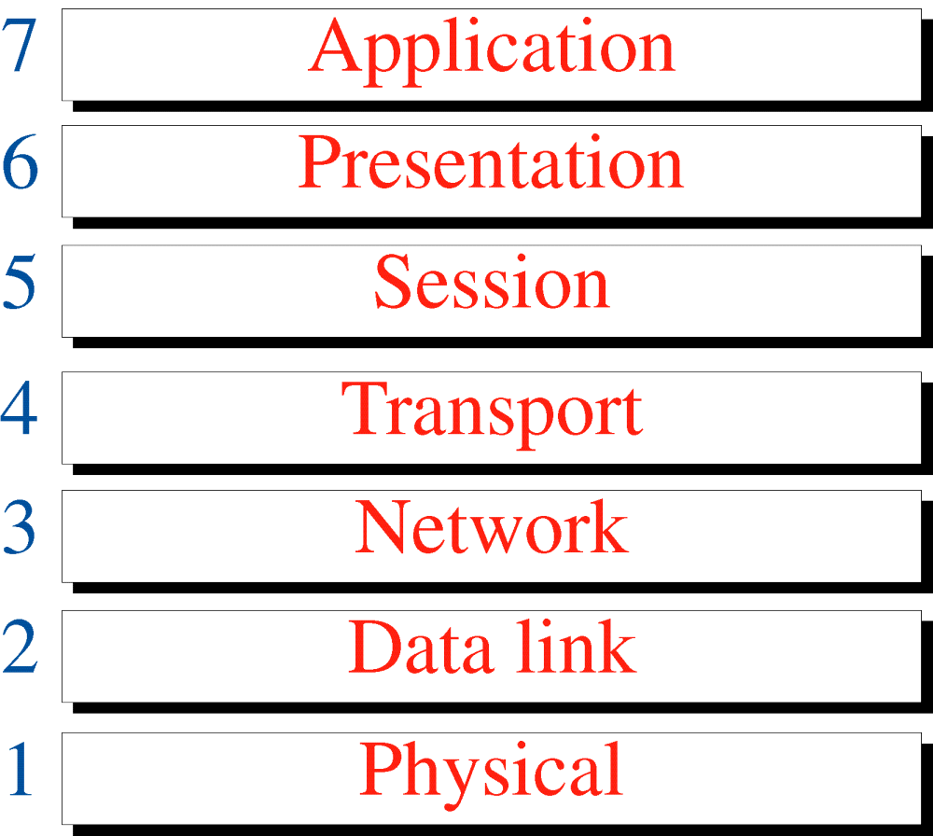
Figure 3-1
OSI Model
WCB/McGraw-Hill
© The McGraw-Hill Companies, Inc., 1998

Slide 3
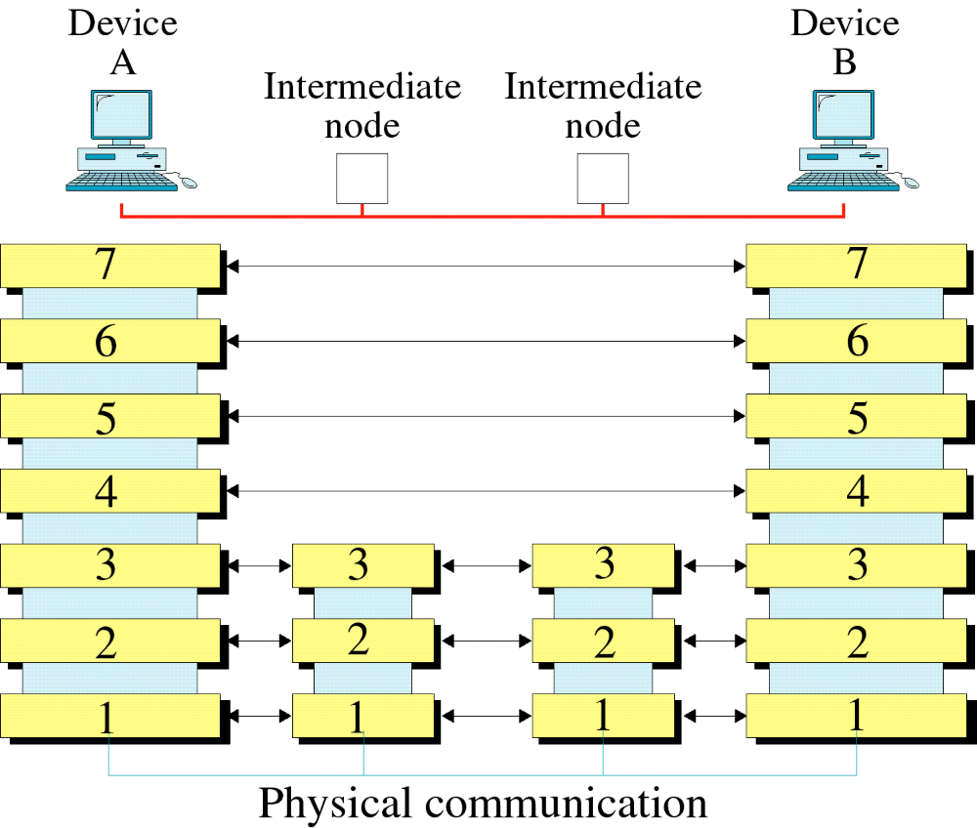
Figure 3-2
OSI Layers
WCB/McGraw-Hill
© The McGraw-Hill Companies, Inc., 1998

Slide 4
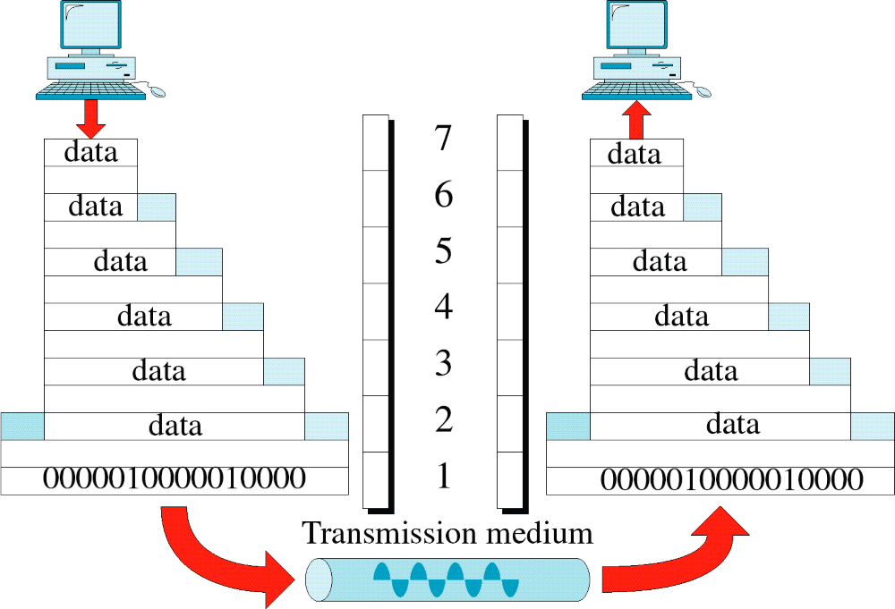
Figure 3-3
An Exchange Using the OSI Model
WCB/McGraw-Hill
© The McGraw-Hill Companies, Inc., 1998

Slide 5
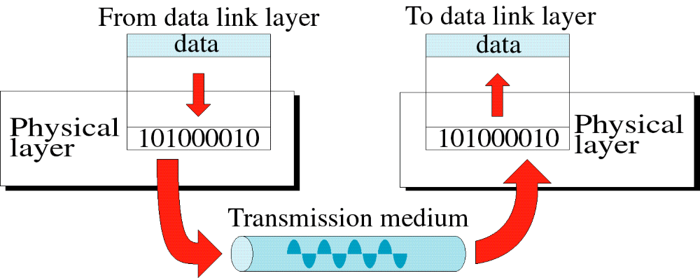
Figure 3-4
Physical Layer
WCB/McGraw-Hill
© The McGraw-Hill Companies, Inc., 1998

Slide 6
Physical Layer
The physical layer is responsible for moving individual bits from one (node) to the next.
Functions:
Physical characteristics of interfaces and media:
  Interface between the devices and the transmission media.
Representation of bits:
  Stream of bits (sequence of 0s or 1s) encoded into signals electrical or optical.
Data rate:
  Transmission rate—the number of bits sent each second.

Slide 7
Physical Layer
Functions:
Synchronization of bits:
  The sender and the receiver clocks must be synchronized.
Line configuration:
  Connection of devices to the media- point-to-point configuration, multipoint configuration
Physical topology :
  Defines how devices are connected to make a network- Star, Bus, Ring, Mesh,
Transmission mode:
  Direction of transmission between two devices: simplex, half-duplex, or full-duplex

Slide 8
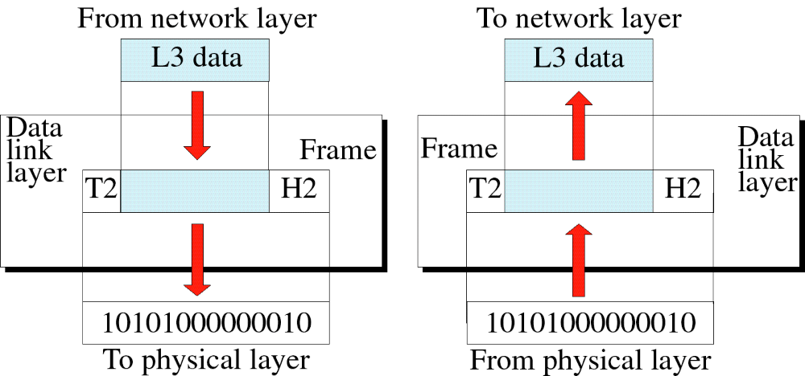
Figure 3-5
Data Link Layer
WCB/McGraw-Hill
© The McGraw-Hill Companies, Inc., 1998

Slide 9
Data Link Layer
The data link layer is responsible for moving frames from one hop (node) to the next.
Functions:
Framing:
  Divides the stream of bits received from the network layer into manageable data units called frames.
Physical addressing:
  If frames are to be distributed to different systems on the network, the data link layer adds a header to the frame to define the sender and/or receiver of the frame.
  If the frame is intended for a system outside the sender’s network, the receiver address is the address of the connecting device that connects the network to the next one.

Slide 10
Data Link Layer
Functions:
Flow control:
  If the rate at which the data is absorbed by the receiver is less than the rate produced at the sender, the data link layer imposes a flow control mechanism to prevent overwhelming the receiver.
Error control:
  Adds reliability to the physical layer by adding mechanisms to detect and retransmit damaged or lost frames.
  It also uses a mechanism to recognize duplicate frames.
  Error control is normally achieved through a trailer added to the end of the frame.
Access control:
  Determine which device has control over the link at any given time.

Slide 11
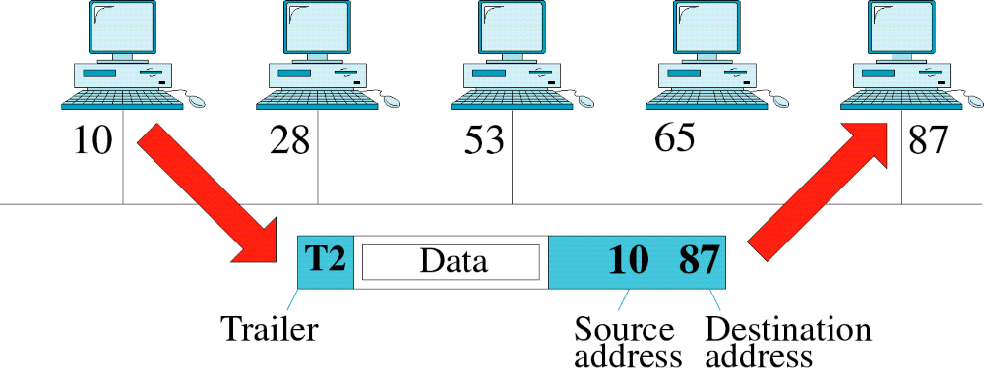
Figure 3-6
Data Link Layer Example
WCB/McGraw-Hill
© The McGraw-Hill Companies, Inc., 1998

Slide 12
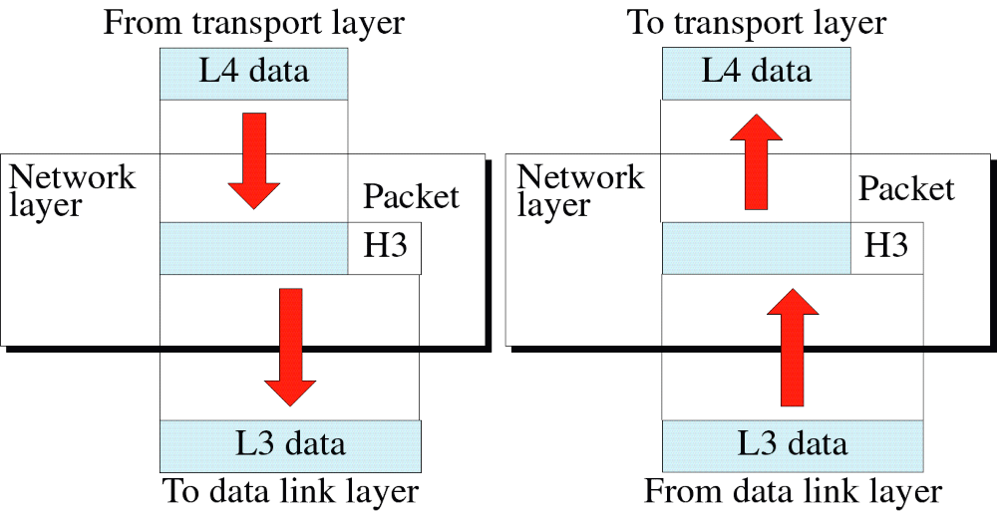
Figure 3-7
Network Layer
WCB/McGraw-Hill
© The McGraw-Hill Companies, Inc., 1998

Slide 13
Network Layer
The Network layer is responsible for the delivery of individual packets from the source host to the destination host.
Functions:
Logical addressing:
  Data link layer only handles the addressing problem locally (using Physical addressing).
  If a packet passes the network boundary, we need another addressing system to help distinguish the source and destination systems.
Routing:
  Route or switch the packets to final destination.

Slide 14
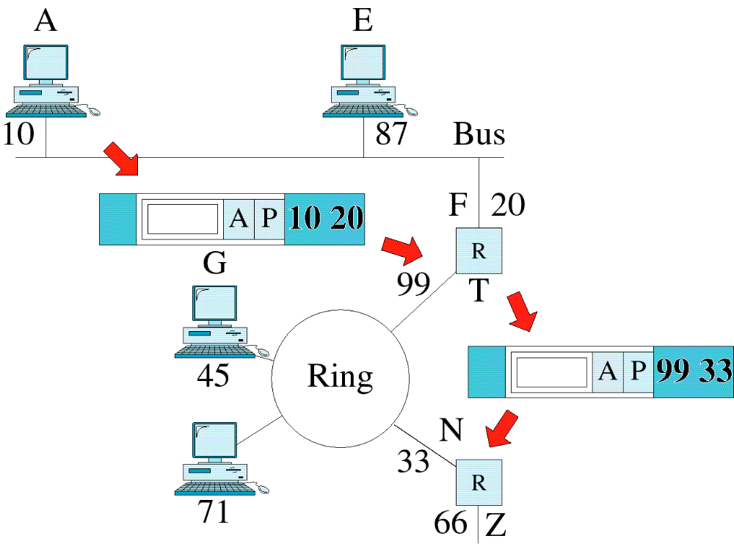
Figure 3-8
Network Layer Example
WCB/McGraw-Hill
© The McGraw-Hill Companies, Inc., 1998

Slide 15
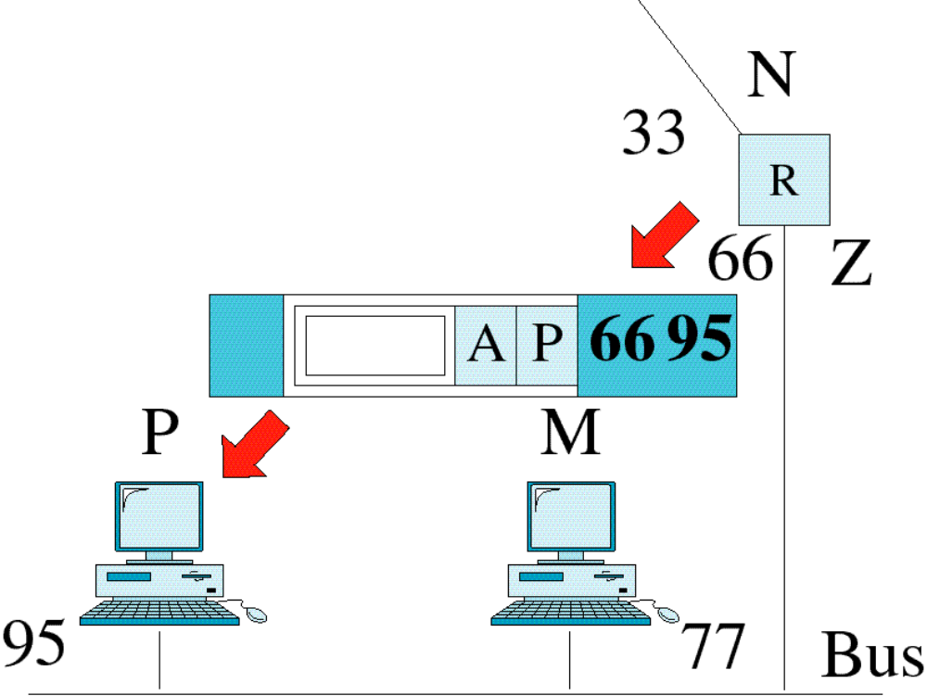
Figure 3-8-continued
Network Layer Example
WCB/McGraw-Hill
© The McGraw-Hill Companies, Inc., 1998

Slide 16
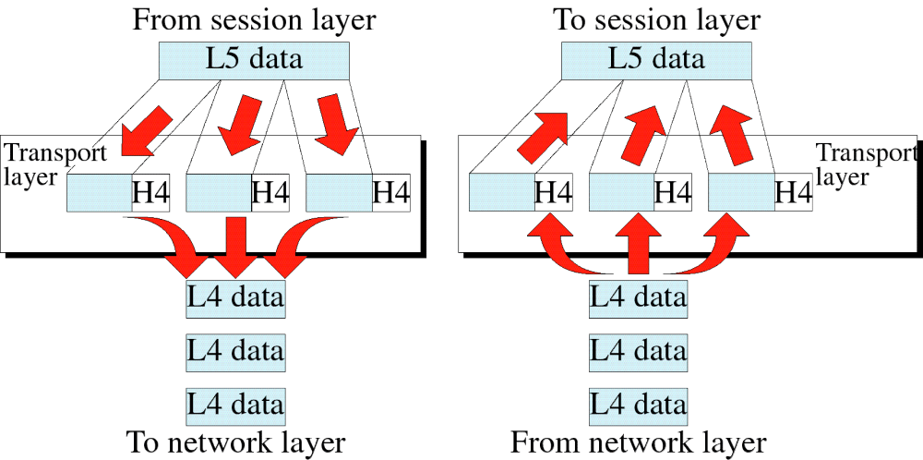
Figure 3-9
Transport Layer
WCB/McGraw-Hill
© The McGraw-Hill Companies, Inc., 1998

Slide 17
Transport Layer
The Transport layer is responsible for process to process delivery of the entire message.
Functions:
Service-point addressing:
  Delivery from specific process on one computer to a specific process on the other.
  Transport layer gets the entire message to the correct process on that computer.
Segmentation and reassembly:
  A message is divided into transmittable segments, with each segment containing a sequence number.
  Sequence numbers enable the transport layer to reassemble the message correctly upon arriving at the destination
  To identify and replace packets that were lost in transmission.

Slide 18
Transport Layer
Functions:
Connection control:
  Connection oriented –
    Makes a connection with the transport layer at the destination machine first before delivering the packets, after data transfer release connection.
  Connection less –
    Treats each segment as an independent packet and delivers it to the transport layer at the destination machine.
Flow control:
  Like data link layer transport layer is responsible for flow control.
  flow control at this layer is performed end to end rather than across a single link.

Slide 19
Transport Layer
Functions:
Error control:
  Like data link layer transport layer is responsible for error control.
  error control at this layer is performed process-to-process rather than across a single link.
  The sending transport layer makes sure that the entire message arrives at the receiving transport layer without error (damage, loss, or duplication).
  Error correction is usually achieved through retransmission.

Slide 20
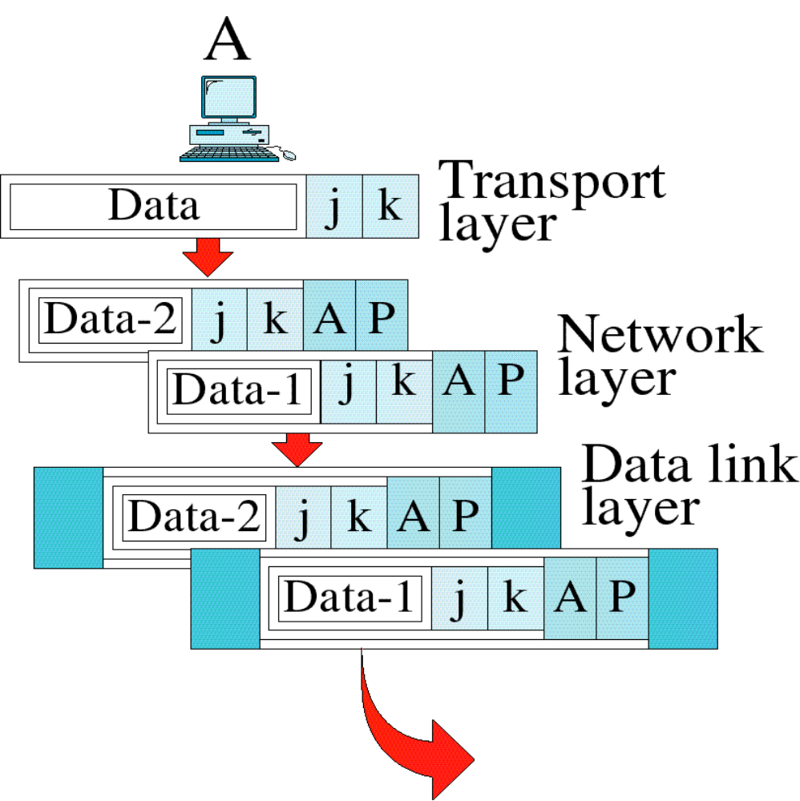
Figure 3-10
Transport Layer Example
WCB/McGraw-Hill
© The McGraw-Hill Companies, Inc., 1998

Slide 21
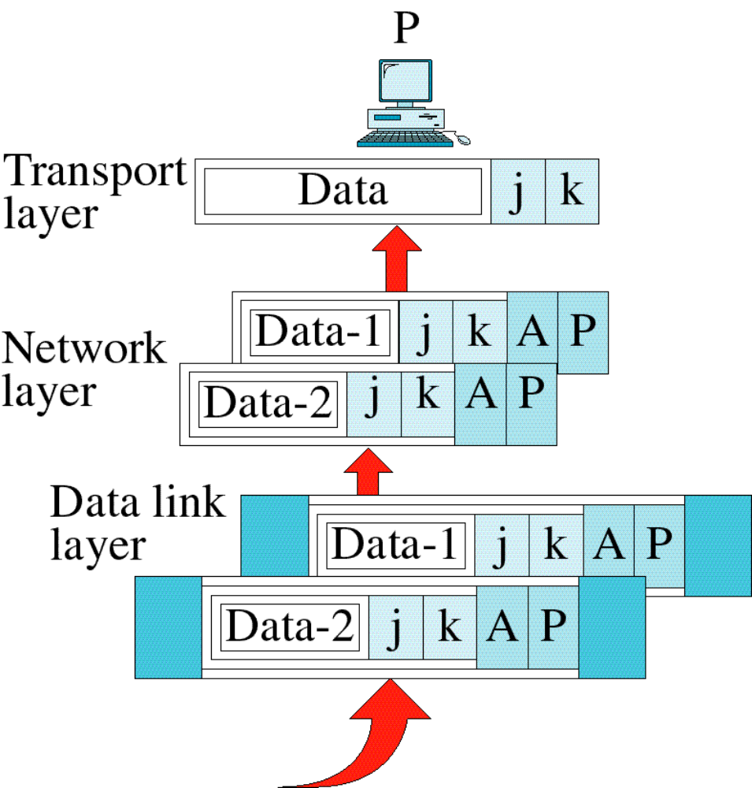
Figure 3-10-continued
Transport Layer Example
WCB/McGraw-Hill
© The McGraw-Hill Companies, Inc., 1998

Slide 22
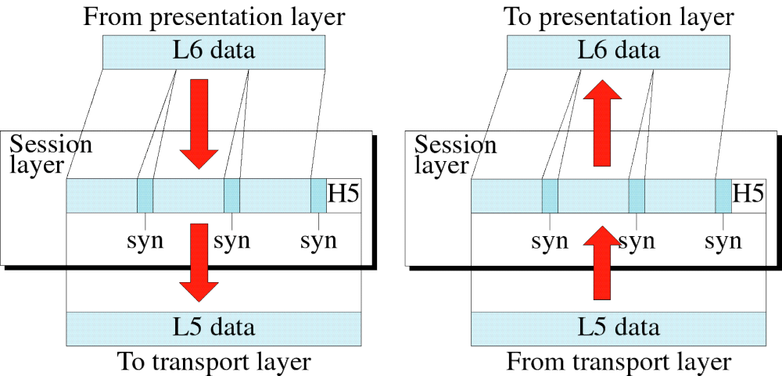
Figure 3-11
Session Layer
WCB/McGraw-Hill
© The McGraw-Hill Companies, Inc., 1998

Slide 23
Session Layer
The Session layer is responsible for dialog control and synchronization.
Functions:
Dialog control:
  Allows two systems to enter into a dialog.
  Allows the communication between two processes to take place in either half duplex or full-duplex mode.
Synchronization:
  The session layer allows a process to add checkpoints (synchronization points) into a stream of data.
    For example, if a system is sending a file of 2,000 pages, it is advisable to insert checkpoints after every 100 pages to ensure that each 100-page unit is received and acknowledged independently. In this case, if a crash happens during the transmission of page 523, the only pages that need to be resent after system recovery are pages 501 to 523. Pages previous to 501 need not be resent.

Slide 24
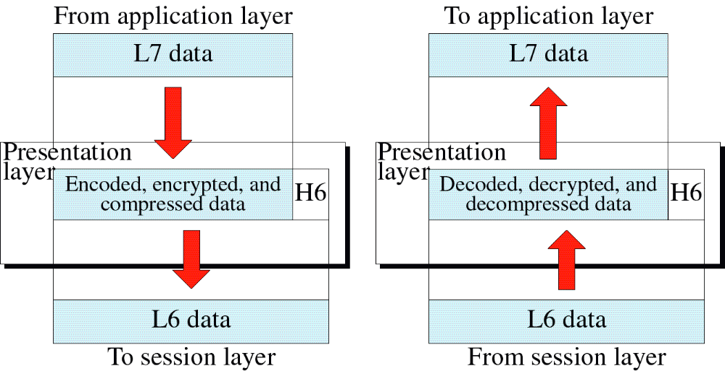
Figure 3-12
Presentation Layer
WCB/McGraw-Hill
© The McGraw-Hill Companies, Inc., 1998

Slide 25
Presentation Layer
The Session layer is responsible for translation, compression, and encryption.
Functions:
Translation:
  Exchange of information between process is in the form of character strings, numbers, and so on.
  The information should be changed to bit streams before being transmitted.
  Different computers use different encoding systems
  Presentation layer is responsible for interoperability between these different encoding methods.
  The presentation layer at the sender changes the information from its sender-dependent format into a common format.
  The presentation layer at the receiving machine changes the common format into its receiver-dependent format.

Slide 26
Presentation Layer
Functions:
Encryption:
  To carry sensitive information a system must be able to assure privacy.
  Encryption means that the sender transforms the original information to another form and sends the resulting message out over the network.
  Decryption reverses the original process to transform the message back to its original form.
Compression:
  Data compression reduces the number of bits contained in the information.
  Data compression becomes particularly important in the transmission of multimedia such as text, audio, and video.

Slide 27
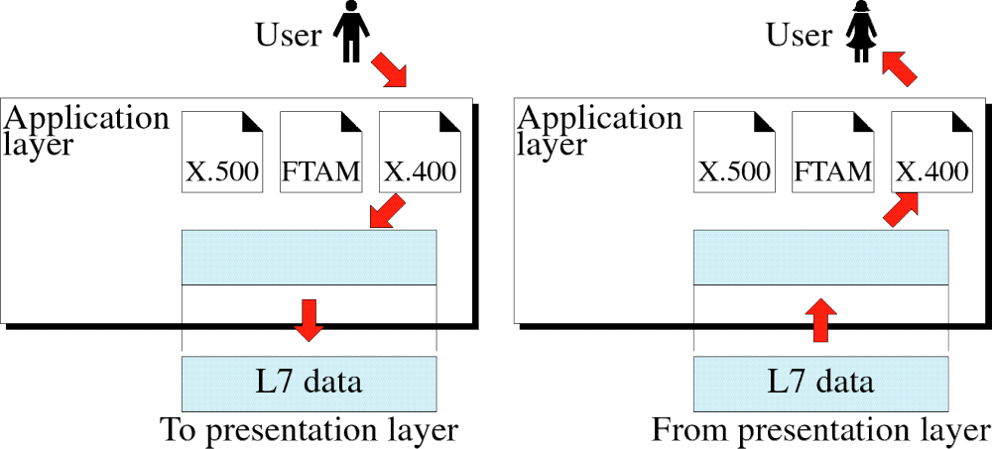
Figure 3-13
Application Layer
WCB/McGraw-Hill
© The McGraw-Hill Companies, Inc., 1998

Slide 28
Application Layer
The Session layer is responsible for providing services to the user.
Functions:
Network virtual Terminal:
  NVT is a software version of a physical terminal and allows a user to log on to a remote host.
File transfer, access, and management:
  Allows a user to access files in a remote, to retrieve files from a remote computer for use in the local computer, and to manage or control files in a remote computer locally.
Mail services:
  Provides the basis for e-mail forwarding and storage.
Directory services:
  provides distributed database sources and access for global information about various objects and services.

Slide 29

Figure 3-14
Summary of Layer Functions
WCB/McGraw-Hill
© The McGraw-Hill Companies, Inc., 1998

Slide 30

TCP/IP and OSI Model

